Slide 1
Neural Substrates of Attention and Awareness
Dan Birman
Gardner Lab
Kalanit Lab Meeting – 2015-02-06

Slide 2


Notes:
Show animation, then go back and repeat: asking to attend to background (21 total black dots move, 22 with the first)

Slide 3
Notes:
Show animation, then go back and repeat: asking to attend to background (21 total black dots move, 22 with the first)

Slide 4
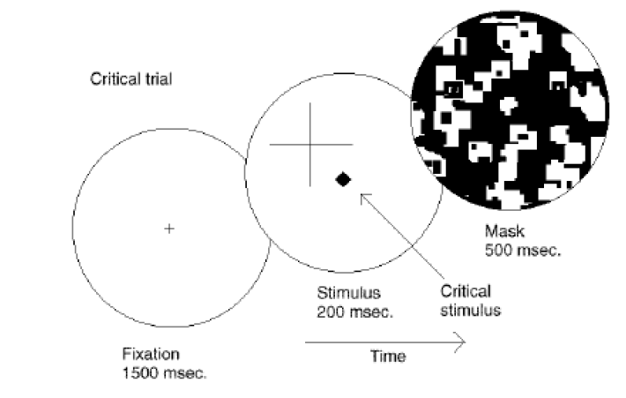
Attention as a Pre-Requisite to Awareness
Dual task designs often “pull” attention to one task, causing inattentional blindness for other stimuli.
“the hypothesis that we believe the evidence presented in this book supports is that there is no conscious perception without attention” (Mack & Rock, 1998)
Mack & Rock, 1998

Slide 5
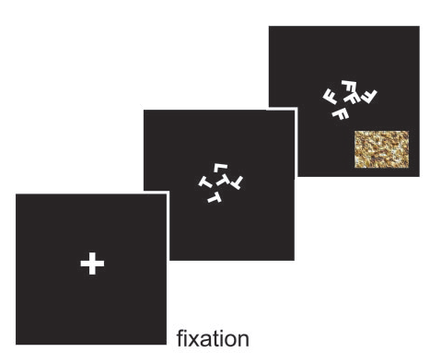
Gist Perception
Li et al., 2002
Reddy et al., 2004

Slide 6
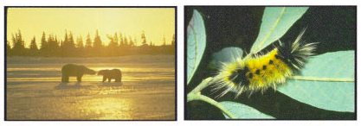
Gist Perception
Li et al., 2002
Reddy et al., 2004

Slide 7
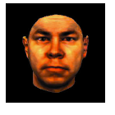
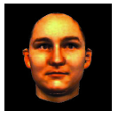
Gist Perception
Li et al., 2002
Reddy et al., 2004

Slide 8
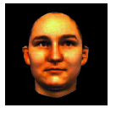
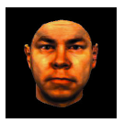
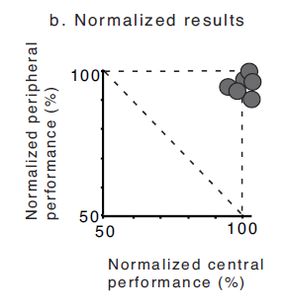
Gist Perception
Li et al., 2002
Reddy et al., 2004

Slide 9
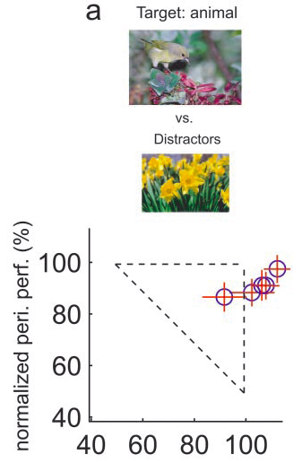
Gist Perception
Li et al., 2002
Reddy et al., 2004

Slide 10
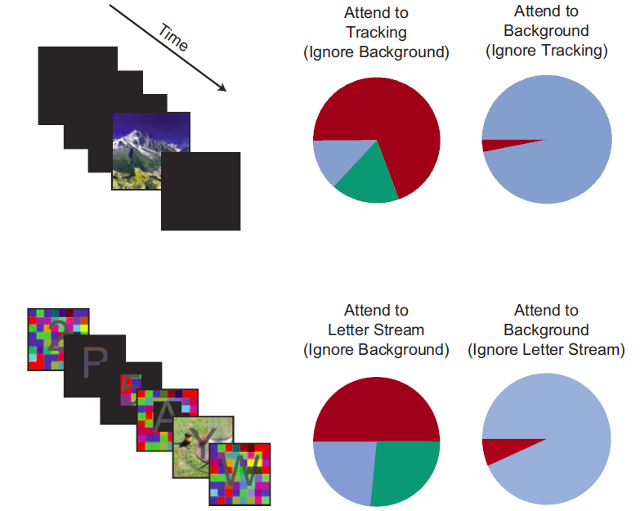
Gist Perception: Impossible Under Load?
Blind
Classified
Saw
Cohen et al., 2011

Slide 11
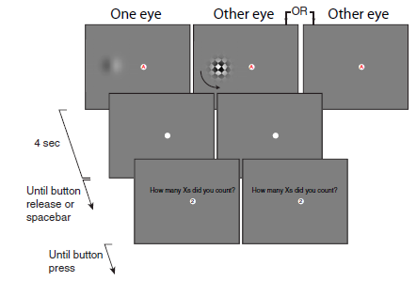
Attempts to Dis-Entangle Attention/Awareness
Dual Task Designs where attention is crossed with awareness. How does a dependent measure, e.g. afterimage length, depend on these factors?
van Boxtel et al., 2010

Slide 12
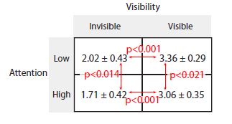
Attempts to Dis-Entangle Attention/Awareness
Afterimage Length (s)
van Boxtel et al., 2010

Slide 13


Operational Definitions vs. Neural Activity
http://www.globeimages.net/data/media/180/berlin_cathedral_front.jpg

Slide 14
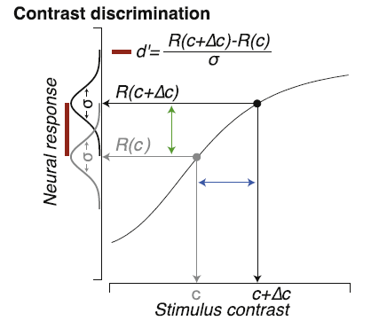
Identifying Neural Substrates
Pestilli et al., 2011

Slide 15
Identifying Neural Substrates
Pestilli et al., 2011

Slide 16
Identifying Neural Substrates
Pestilli et al., 2011

Slide 17
Identifying Neural Substrates
Pestilli et al., 2011

Slide 18
Identifying Neural Substrates
Pestilli et al., 2011

Slide 19
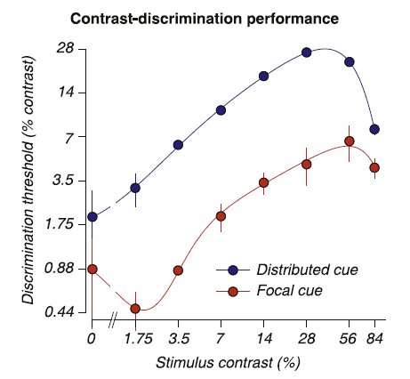
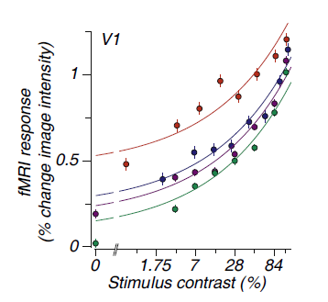
Identifying Neural Substrates
Behavioral Performance ←→ BOLD Magnitude
Pestilli et al., 2011

Slide 20
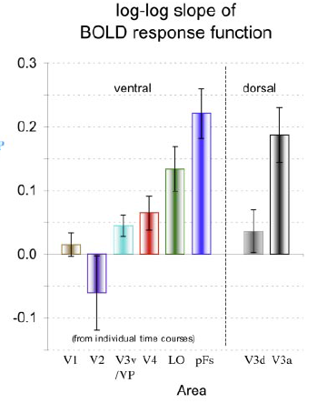
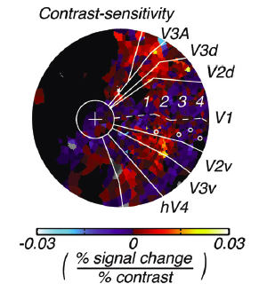
Feature Dependent Neural Substrates
to objects
in noise
Hara et al., 2014
Tjan et al., 2006

Slide 21
Conceptual Overview: Attention & Awareness
“Recent research has slowly corroded a belief that selective attention and consciousness are so tightly entangled that they cannot be individually examined.” (van Boxtel et al. 2010)
Dropping operational definitions grounded in behavior in favor of a neural substrate model of attention and awareness:
- Attention as a local context-specific modulation
- Perceptual awareness as a downstream processing of same neural activity
Collecting data for a computational model of attention / awareness? One idea: dual tasks with competing features.

Slide 22
Extracting Selective from Spatial Attention
Face_grid missing

Slide 23


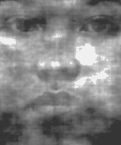


Discriminate Contrast
Or
Discriminate Noise

Slide 24

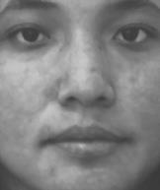

Slide 25
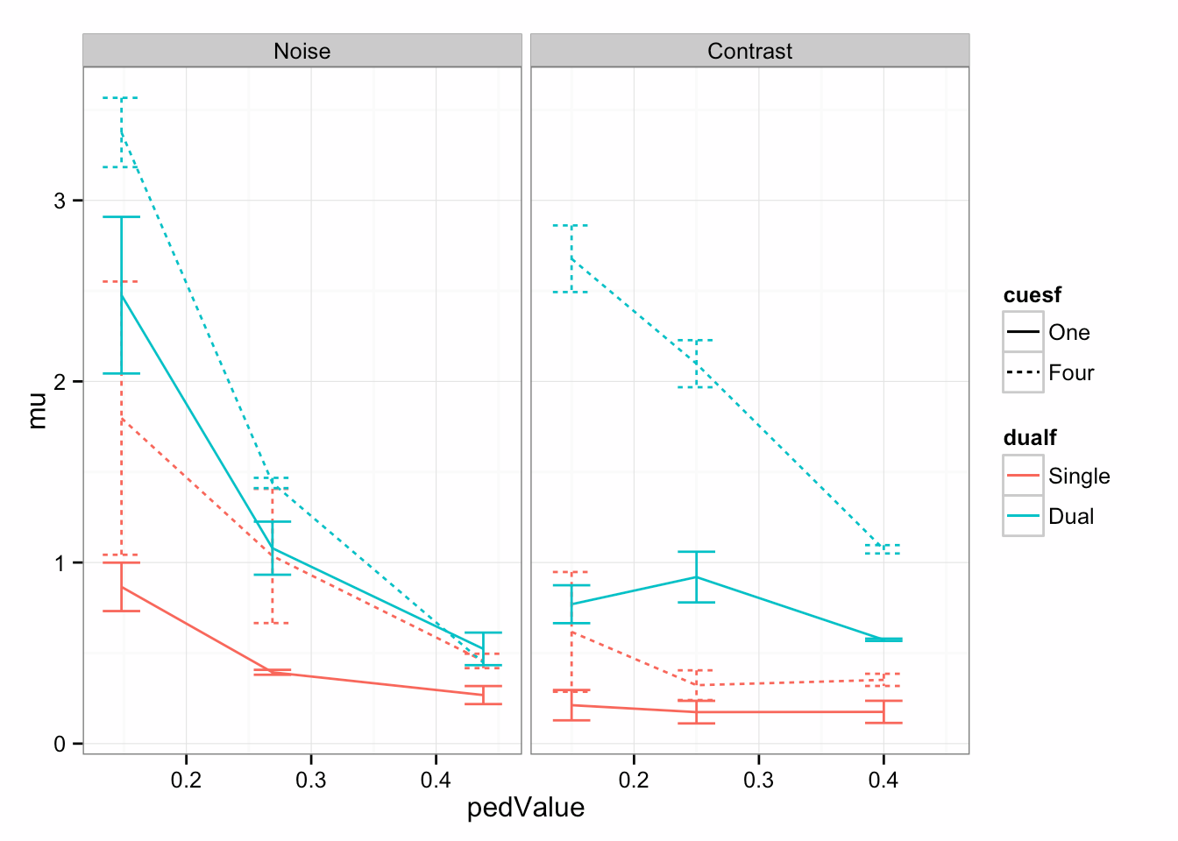
Attention * Awareness
Notes:
Remember to talk about your prediction: noise + gender = worse performance, contrast + gender = better performance

Slide 26
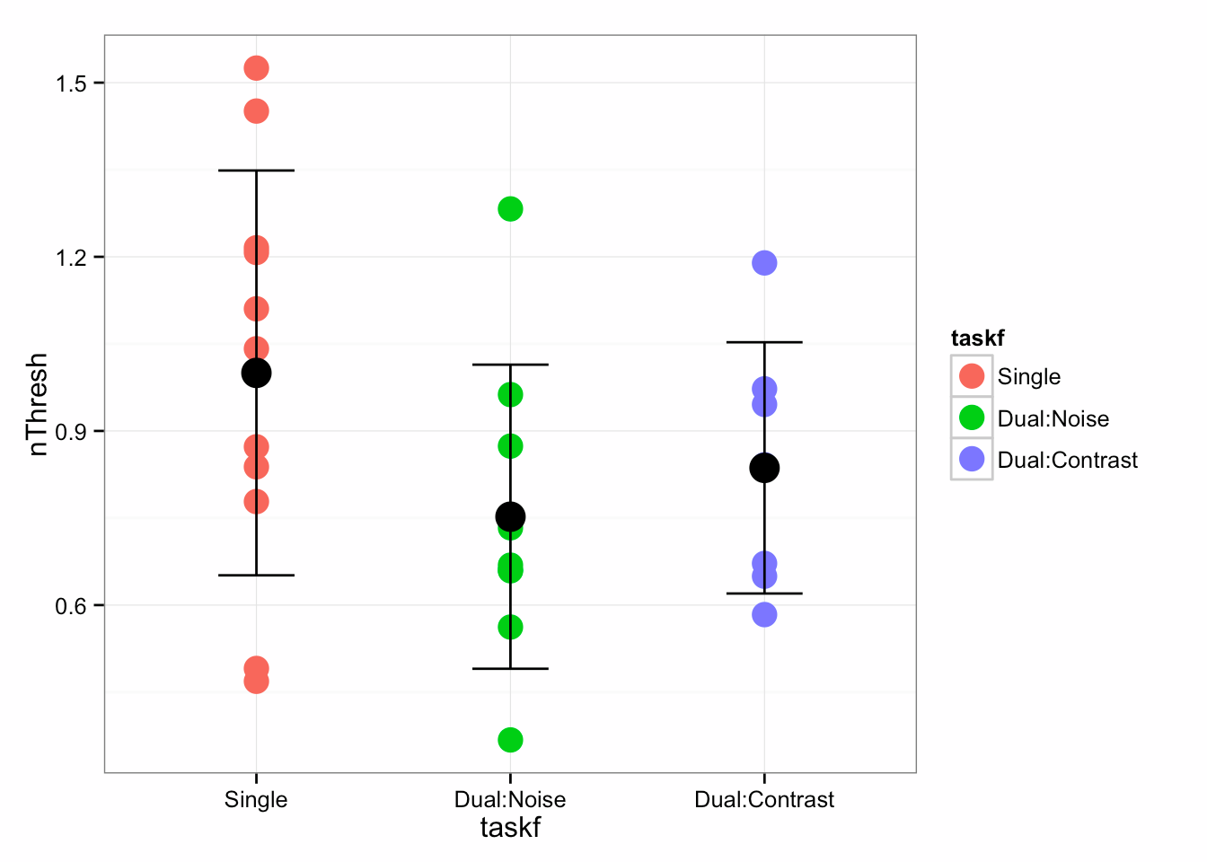
Attention * Awareness

Slide 27
Dual Task Issues
Difficulty: Previous Slides contain >10,000 trials (7s per trial)
Cross-task Comparisons Impossible (noise threshold vs. contrast threshold?)
Cross-task interference: Hard to control which task is the ‘main task’ and which task has deteriorating performance.
Bottom-up vs. top-down attentional effects
More general: Is a drop in performance a change in “awareness”, or a change in “attention”? You can be “aware” of both increments and gender changes while attending to either.

Slide 28





Possible solution: Graded Change Blindness?
Less prone to bottom-up attentional effects
No training required
Signal detection rather than forced choice discrimination: allows for a direct measurement of “awareness” in the direct sense.
Still allows for similar contrast and noise discrimination functions
Catch trials: Measuring awareness
In the absence of top-down attention

Slide 29
What kind of analyses can be done using the data from this?
Global vs local attention effect (neural response)
Feature attention effect (neural response)
Computational Model linking attention -> behavior (awareness)
Does a model of neural response match a model of behavior? Or is a portion
Of the neural response unnecessary
Catch trials: awareness of un-attended items

Slide 30




Gardner Lab @ Stanford University
Justin Gardner
Steeve Laquitaine
Thanks for your Attention and Awareness!

